Slide 1


Langflow
Visual Orchestration
[presenter's first name]
February 5, 2026

Slide 2
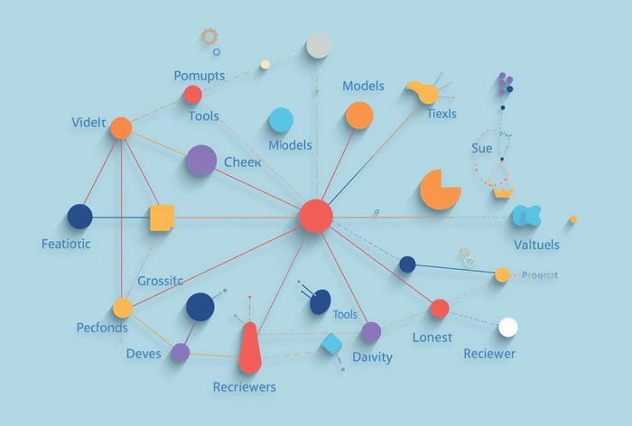
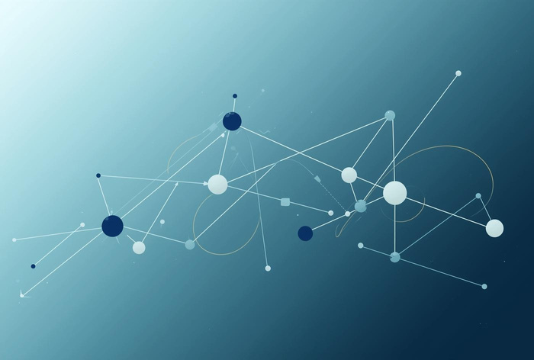
Core Components
Nodes
Essential building blocks for LLM workflows.
Edges
Represent the data and execution flow between nodes.

Slide 3

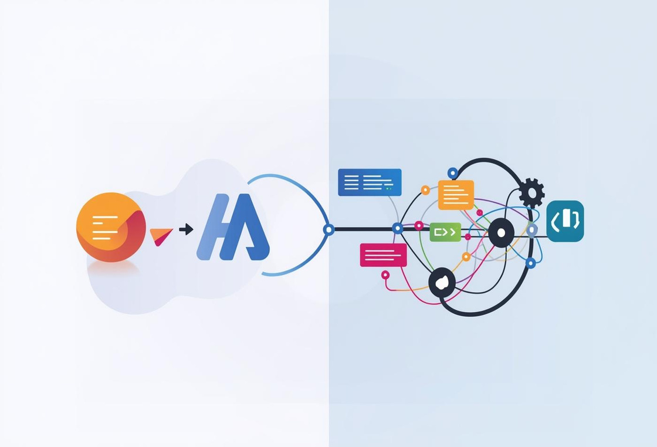

Accelerate Your Development Process with Visuals
Simplify Complex Processes with Clear Visuals
Foster Teamwork Through Visual Collaboration
Get Started
Discover More
Join Us Today

Slide 4
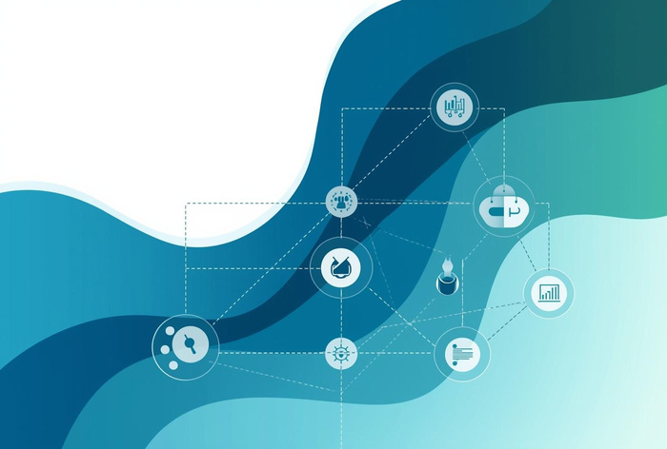
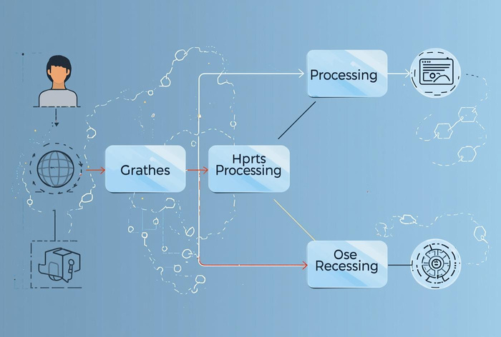
Common Use Cases
Retrieval-Augmented Generation
RAG enhances LLM capabilities by integrating retrieval mechanisms for rich responses.
Agent Workflows
Agent workflows streamline interactions, allowing LLMs to efficiently manage tasks and responses.

Slide 5
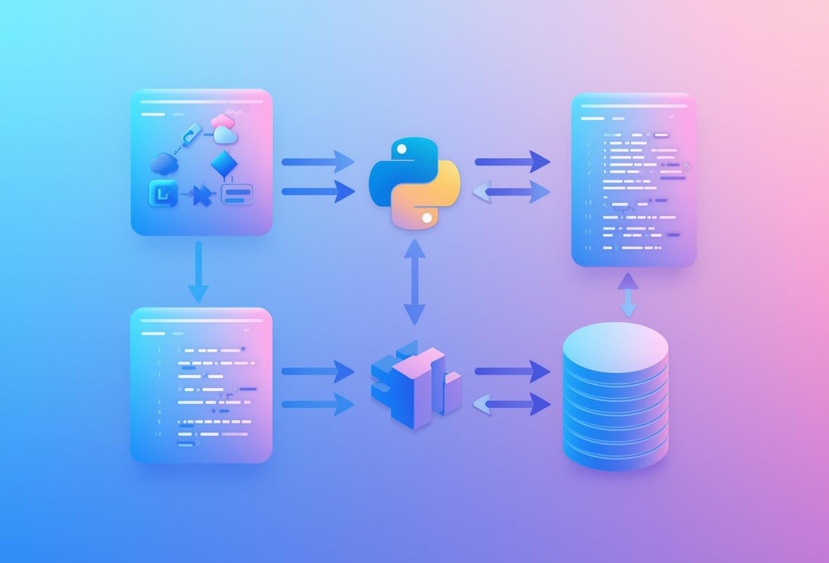
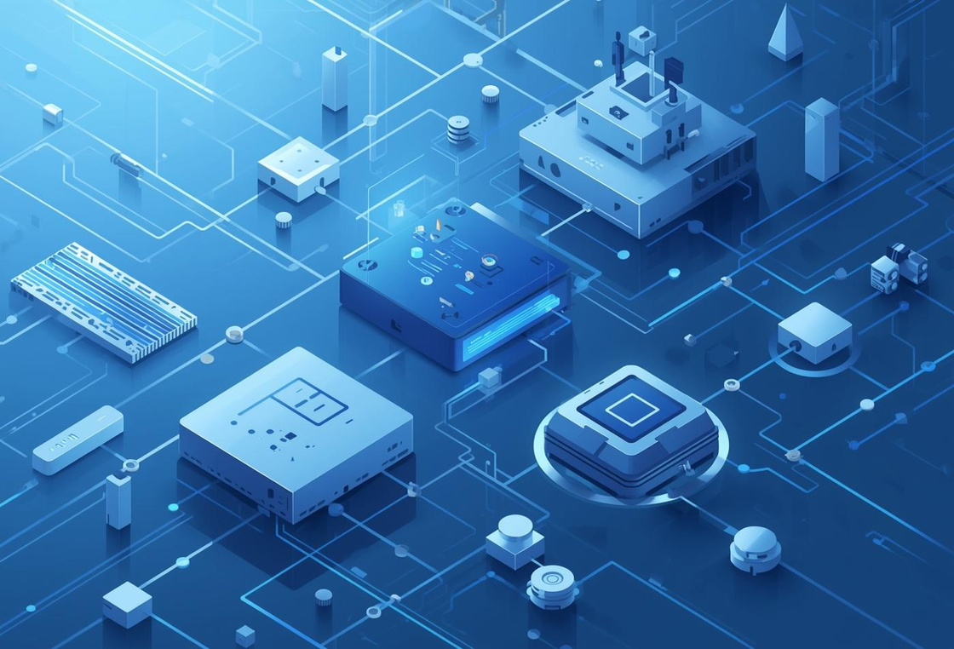

Transforming visual designs into executable code
Creating tailored integrations for your needs
Ensuring seamless transition to production stages
Learn more
Explore options
Get started

